Slide 1
CMMI
Lecturer: Ngo Huy Bien
Software Engineering Department
Faculty of Information Technology
VNUHCM - University of Science
Ho Chi Minh City, Vietnam
nhbien@fit.hcmus.edu.vn

Slide 2

Objectives
To present what is CMMI.
To present why use CMMI.
To present CMMI structure.

Slide 3

References
Margaret K. Kulpa and Kent A. Johnson (2003). Interpreting the CMMI: A Process Improvement Approach.
Tim Kasse (2008). Practical Insight into CMMI.

Slide 4
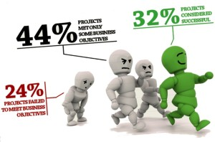

Why Use a Process? [1]
A process is a series of steps that help to solve a problem.
A process helps us do things consistently.
Why do we want to do things consistently?
Are we promoting turning the workers into robots?
No. What focusing on process does for your organization is to reduce redundant work.

Slide 5
Why is Process Important?
Why not focus on the product, or the people, or the technology used?
Give guidelines to the people responsible for doing this work on how to do it.
Rather than having people work harder, have them work smarter.
Most of those companies sold quick-fix technologies without any underlying analysis of the problems organizations faced.
Is process the only answer?
No. Process is part of the answer.
Process, when supported by training, enough money, enough skilled people, proper tools, and management commitment, can help your organization.

Slide 6

Defining Process Steps
The steps must be defined in such a way as to be unambiguous — that is, readily understood and capable of being followed in a consistent manner by anyone using the process.
Example: A risk management process
Identify the risks
Analyze the risks
Categorize the seriousness and probability of the risks
Mitigate the risks
What is the problem with this process?
It is too general.
Each manager would have interpreted how to do this process differently.

Slide 7
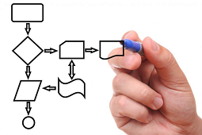
Procedures
Clarify how we do the steps in your process?
Identify the risk.
Track the problems they have in delivering products and then find trends.
From the list of trends, create a list of the ten most frequently occurring problems on the projects.
Categorize the seriousness and probability of the risk.
Define risks as 1 — most critical and most likely to occur; 2 — critical but work may continue; and 3 — not critical, work may continue, fix this problem during the next phase or release.
Define procedures for how to determine what would put a risk into category 1, 2, or 3.

Slide 8

Procedures vs. Processes
Procedures are step-by-step instructions on how to perform a task.
Procedures are a subset of processes.
The process is what to do; the procedures are how to do the steps in the process.

Slide 9
Procedure Template
Document Number: | Date:
 | Revision Number
Description:
This procedure involves… The activity's primary aim is to...
Entry Criteria/Inputs: | Exit Criteria/Outputs:
Roles: Role Name: What does s/he do?
Assets: Standards, reference material, deliverables, previous process descriptions…
Summary of Tasks (list major tasks/process steps): Task 1 Task 2 Task 3 Task 4
Procedure Steps:
Task 1 Detail Step 1 Detail Step 2 Detail Step 3 Detail Step 4
Task 2

Slide 10
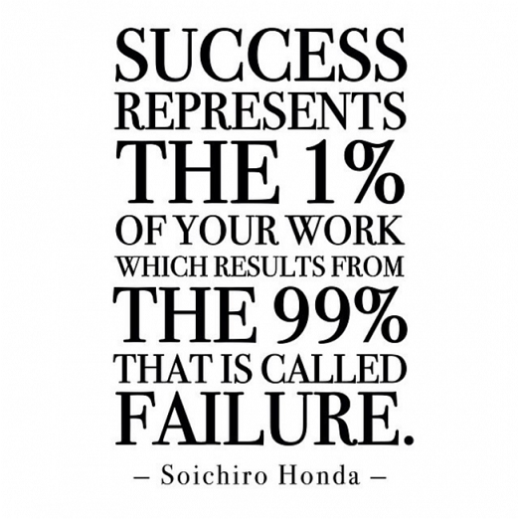
Our Process Does Not Work!

Slide 11
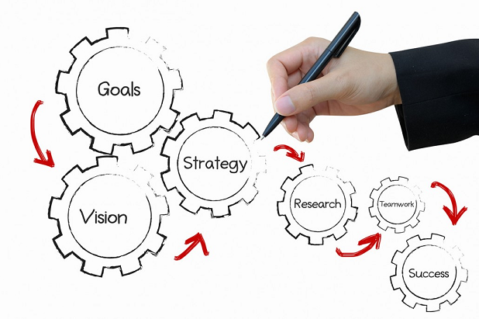
Improve Your Process

Slide 12
How to Improve a Process?
Problem: We cannot keep up with the number of requirements changes.
Goal: To improve our requirements change process.
Question: How can we improve our requirements change process?
Metric:
Number of requirements changes submitted, approved, implemented, or
cancelled versus the number of original requirements documented.
Time it takes to implement a change in requirements.
Solution (What should we do?): Trial and Error?

Slide 13

Solution: Use a Model

Slide 14
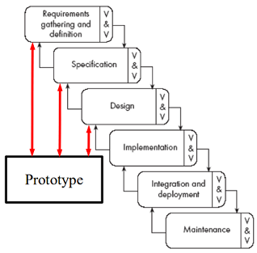
Models
A model is considered a guideline of best practices found by studying other, highly functioning and successful organizations.
A model does not contain the steps needed or the sequence of steps needed to implement a process improvement program.
The model used simply says, "this is a good thing to do.“
Why use a model?
Without using a model as your basis of reference, you have nothing around which to plan your improvement, and nothing against which to measure your results.

Slide 15


PA: Requirements Management
SG1: Managed Requirements
SP1.1: Obtain an understanding of requirements
SP1.2: Obtain commitment to requirements
SP1.3: Manage requirements changes
SP1.4: Maintain bi-directional traceability of requirements
SP1.5: Identify inconsistencies between project work and requirements

Slide 16
Why Don’t Create Your Own Model?
It takes a long time and it costs a lot of money.
Most models allow an organization to substitute alternative practices for those practices in the chosen model that do not fit the organization.
ISO stands for International Standards Organization.
The ISO 9000/9001 series generates a fundamental quality management framework.
The CMM stands for the Capability Maturity Model.
The CMM was created by analyzing the activities of highly functioning software organizations; that is, those organizations that consistently delivered software systems to their customers on time, within budget, and that actually worked.

Slide 17


Slide 18
Introduction [2]
Systems engineering
Covers the development of total systems, which may or may not include software.
Software engineering
Covers the development of software systems.
Integrated product and process development
Achieves a timely collaboration of relevant stakeholders throughout the product life cycle to better satisfy customer needs.

Slide 19
Capability Maturity Model Integration
CMMI is a merger of process improvement models for systems engineering, software engineering, integrated product development, and software acquisition.
Process improvement
Goals
Customer’s force
The process improvement view
Views
The assessment view

Slide 20

Maturity Levels [1]
A maturity level signifies the level of performance that can be expected from an organization.
Maturity Level 3: Defined
Maturity Level 2: Managed
Maturity Level 1: Initial
Maturity Level 4: Quantitatively Managed
Maturity Level 5: Optimizing
The process is institutionalized as an optimizing process.
The process is institutionalized as a quantitatively managed process.
The process is institutionalized as a defined process.
The process is institutionalized as a managed process
The process supports and enables achievement of the specific goals.

Slide 21
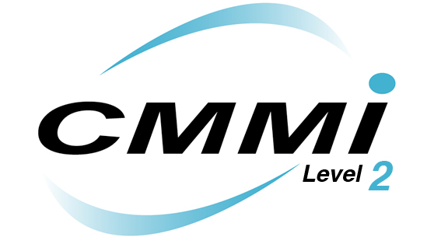
CMMI Level 2 Appraisal

Slide 22
PA: Requirements Management [1]
SG1: Managed Requirements
SP1.1: Obtain an understanding of requirements
SP1.2: Obtain commitment to requirements
SP1.3: Manage requirements changes
SP1.4: Maintain bi-directional traceability of requirements
SP1.5: Identify inconsistencies between project work and requirements

Slide 23
PA: Project Planning
SG1: Establish estimates
SP1.1: Estimate the scope of the project
SP1.2: Establish estimates of work product and task attributes
SP1.3: Define project life cycle
SP1.4: Determine estimates of effort and cost

Slide 24
PA: Project Planning
SG2: Develop a project plan
SP2.1: Establish the budget and schedule
SP2.2: Identify project risks
SP2.3: Plan for data management
SP2.4: Plan for project resources
SP2.5: Plan for needed knowledge and skills
SP2.6: Plan stakeholder involvement
SP2.7: Establish the project plan

Slide 25
PA: Project Planning
SG3: Obtain commitment to the plan
SP3.1: Review plans that affect the project
SP3.2: Reconcile work and resource levels
SP3.3: Obtain plan commitment

Slide 26
PA: Process and Product Quality Assurance
SG1: Objectively evaluate processes and work products
SP1.1: Objectively evaluate processes
SP1.2: Objectively evaluate work products and services
SG2: Provide objective insight
SP2.2: Establish records
SP2.1: Communicate and ensure resolution of noncompliance issues

Slide 27
PA: Configuration Management
SG1: Establish baselines
SP1.1: Identify configuration items
SP1.2: Establish a configuration management system
SP1.3: Create or release baselines
SG2: Track and control changes
SP2.2: Control configuration items
SP2.1: Track change requests
SG3: Establish integrity
SP3.2: Perform configuration audits
SP3.1: Establish configuration management records

Slide 29
Process Areas (PAs)
A process area is a group of practices performed collectively to achieve a specific goal.
Requirements Management
Project Planning
Project Monitoring and Control
Supplier Agreement Management
Measurement and Analysis
Process and Product Quality Assurance

Slide 30
Process Area Groups
Process Management
Organizational Process Focus, Definition, Training...
Project Management
Project Planning, Monitoring, Control...
Engineering
Requirements Management, Development, Technical Solution, Product Integration...
Support
Configuration Management, Process and Product Quality Assurance...

Slide 31
Specific Goals
Specific goals (SG): activities that relate to the specific PA under study.
Practices are activities that must be performed to satisfy the goals for each PA. Each practice relates to only one goal.
Project Planning
SP1: Estimate the scope of the project
Specific Goal 1: Establish estimates
SP2: Determine estimates of effort and cost

Slide 32
Generic Goals
Generic goals (GG): goals that are common to multiple PAs throughout the model; they help determine whether the PA has been institutionalized.
Generic practices (GP): are associated with the generic goals for institutionalization.
GP1: Plan the process
GP2: Provide resources
GP3: Assign responsibility
Generic Goal 2: Institutionalize a Managed Process

Slide 33
Generic Practices Functions (I)
Commitment to Perform (CO) is shown through
senior management commitment and
written policies.
Ability to Perform (AB) is shown through
training personnel in their duties,
providing adequate resources and funding,
assigning responsibility,
planning the process, and
establishing a tailored and defined process.

Slide 34
Generic Practices Functions (II)
Directing Implementation (DI) is demonstrated by
managing configurations,
identifying and involving relevant stakeholders,
monitoring and controlling the process, and
collecting improvement information.
Verifying Implementation (VE) is demonstrated via
objectively evaluating adherence (both process and product adherence to organizational policies, procedures, and standards) and by
reviewing status with higher-level management.

Slide 35
Common Features
Common features group together the generic practices within a PA, according to the function that the practices fulfill.
Commitment to Perform (CO)
Ability to Perform (AB)
Directing Implementation (DI)
Verifying Implementation (VE)

Slide 36
CMMI Other Terms
Typical Work Products: each process area gives examples of typical
documents,
deliverables, or
other outputs produced within the process area.
Sub-practices: lower-level practices that provide more information about the practice.
For example, the Practice may be to write a project plan.
The sub-practice would offer information as to what should go into the project plan itself.

Slide 37
CMMI Other Terms (cont.)
Discipline Amplifications: simple guidance offered to direct the user as to which discipline is more relevant for specific practices, or to offer some guidance in applying the PA to the discipline.
The disciplines are Systems Engineering, Software Engineering, Supplier Sourcing, and Integrated Product and Process Development (IPPD).
Elaborations: more information and examples concerning generic practices.
…

Slide 38
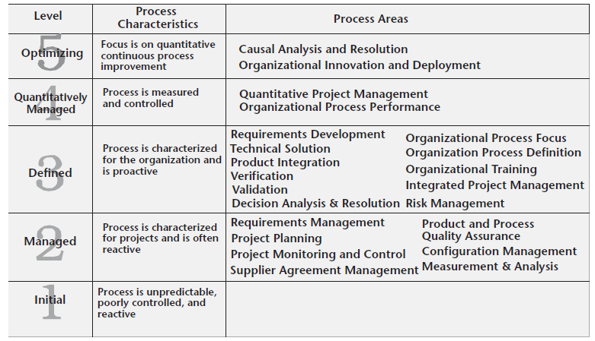
Level & PA [2]

Slide 39
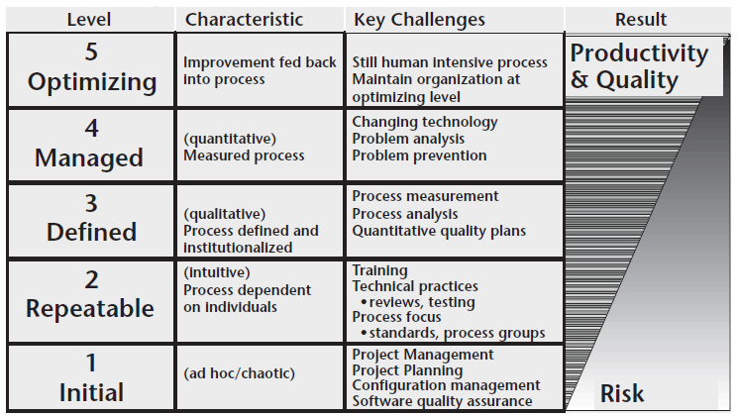
Maturity Level Key Challenges

Slide 40
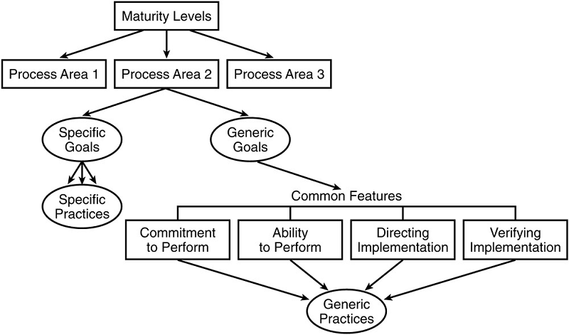
Staged Representation

Slide 41
Capability Levels
Capability levels focus on maturing the organization's ability to perform, control, and improve its performance in a process area.
Capability Level 2: Managed
Capability Level 1: Performed
Capability Level 0: Incomplete
Capability Level 3: Defined
Capability Level 4: Quantitatively Managed
Capability Level 5: Optimizing

Slide 42
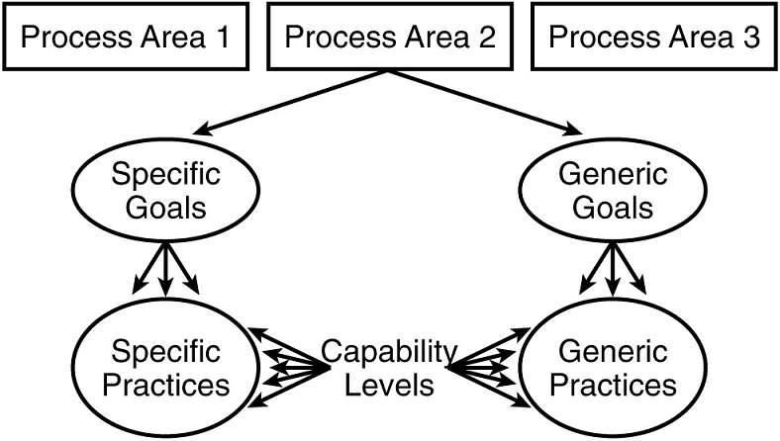
Continuous Representation

Slide 44

Appraisals using the CMMI

Slide 46
ISO 21500
ISO 21500 is the standard that governs project management.
This standard builds on a number of existing standards, and is applicable to organizations of all sizes and natures.
Benefits of the ISO 21500 Standard for project management include:
a higher level of quality management
encouraging transfer of knowledge between projects and organizations for improved project delivery
Facilitating efficient tendering processes through the use of consistent project management terminology
enabling the flexibility of project management employees and their ability to work on international projects
providing a framework as the basis for certification programs
providing universal project management principles and processes

Slide 47

Thank You for Your Time

